Slide 1
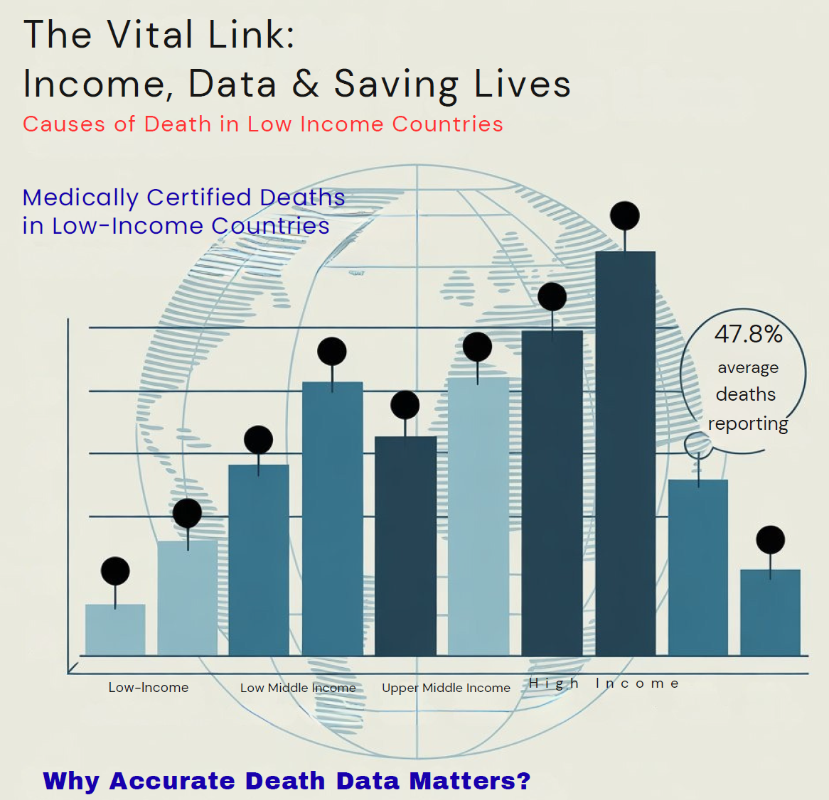
Poster Calling for Actions for Improving Mortality Reporting
Chu Hong Anh

Slide 2
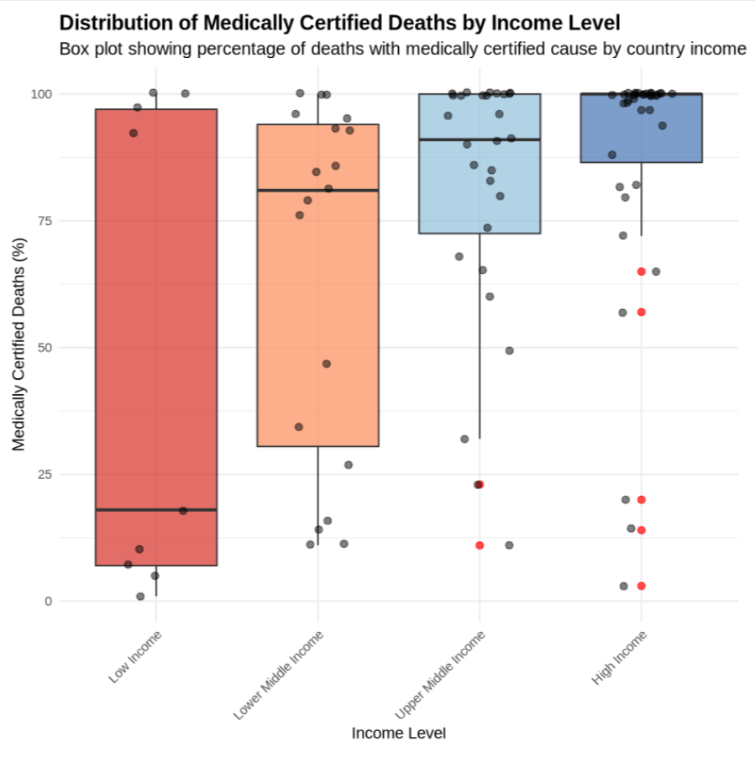
Why Medically Certified Causes of Death Matter
Governments can't prioritize health interventions.
Public health risks are underestimated or missed entirely.
2020:
Only 1 in 3 deaths globally has a medically certified cause.
Much lower rates in low-income countries (8%)
2024:
78% deaths with Medical CoD registered
STILL 8% in low-income countries
Source: WHO SCORE assessment 2020; 2024(draft)

Slide 3
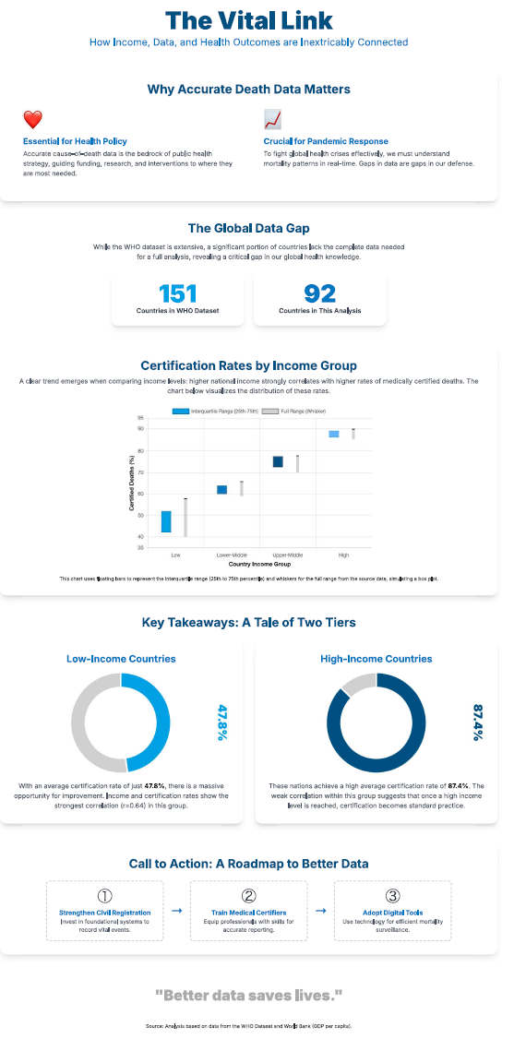
Poster: Call for Action to Improve Reporting Mortality/COD
Source:
WHO. Global excess deaths associated with COVID-19, January 2020 - December 2021. https://www.who.int/data/stories/global-excess-deaths-associated-with-covid-19-january-2020-december-2021
WHO. Global report on health data systems capacity, 2020. https://iris.who.int/bitstream/handle/10665/339125/9789240018709-eng.pdf
Tool: chartGPT, Gemini for build the html codes.
https://gemini.google.com/share/9c676beb8650

Slide 4
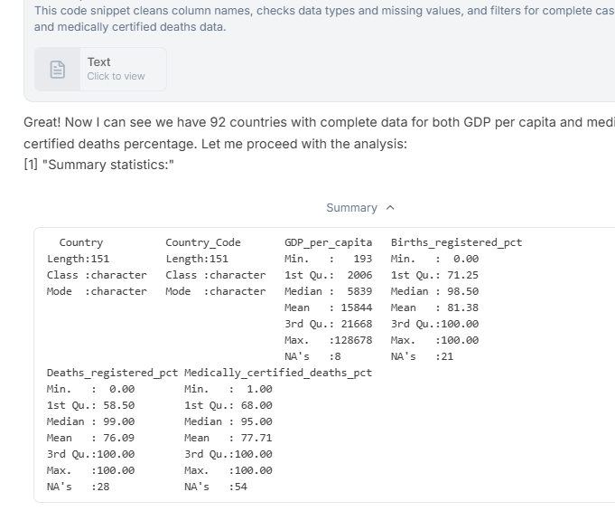
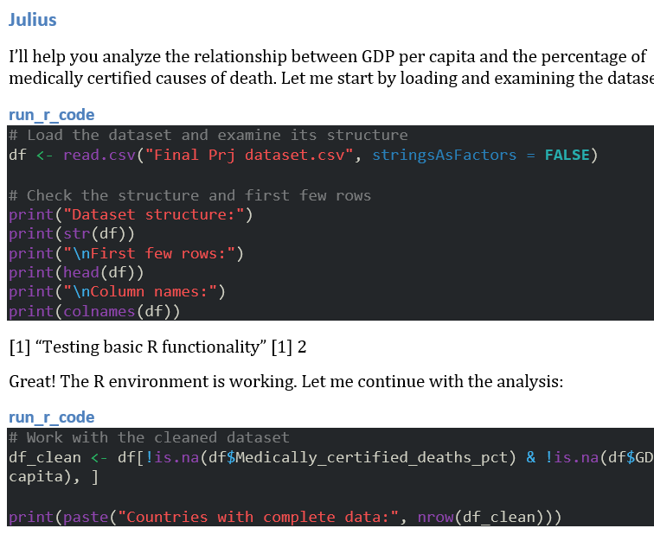
Use of AI Tools
ChatGPT: summarises contexts from various global reports and database
Julius.ai: analyses data from the WB, WHO SCORE dB: income classification; correlation between income groups and % of causes of death reported.
Ideogram.ai, canvas.com: ideas and infographic design of the poster
ChatGPT/Gemini: transfer to html and for PDF;
Common steps via GitHub for link to the website

Slide 5
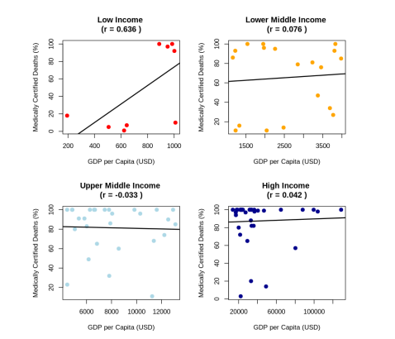
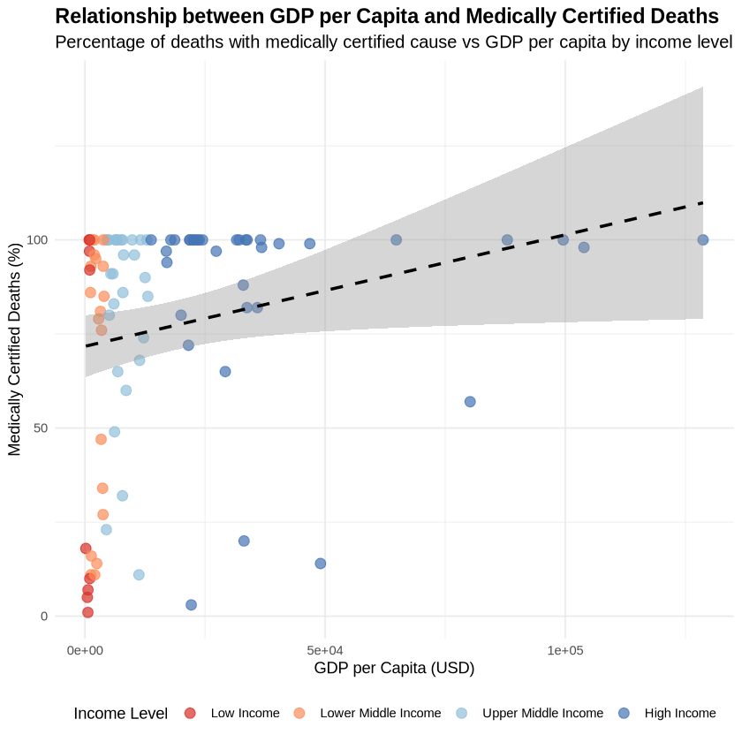
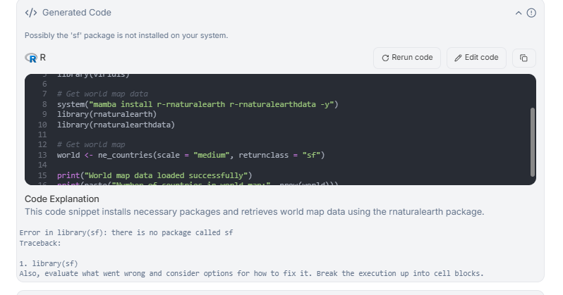
Analysis Outputs:

Slide 6
Observations
Managing Expectation: Need to know well what to look for and expect
Experimenting and trying/testing with different prompts and tools are essential
To learn more about LLM for researching text/ products
Can be expensive & time-consuming (esp. for beginners)!
What works: Julius is very helpful for inexperienced analyst
ChatGPT, Gemini, GitHub and webpage, Chatbot
NEED PRACTICE – LOTS OF IT!
Challenges

Slide 7
Thank you!
I’ve really enjoyed the course and will continue the experiments!

